Slide 1
FINAL PROJECT
GROUP 2: THOR GUNNLAUGSSON JENSEN, JORGE CEBOLLADA AND PAULINE STEINER
CONTROLLING A DC MOTOR WITH A SIGNAL GENERATOR IMPLEMENTED BY FPGA

Slide 2
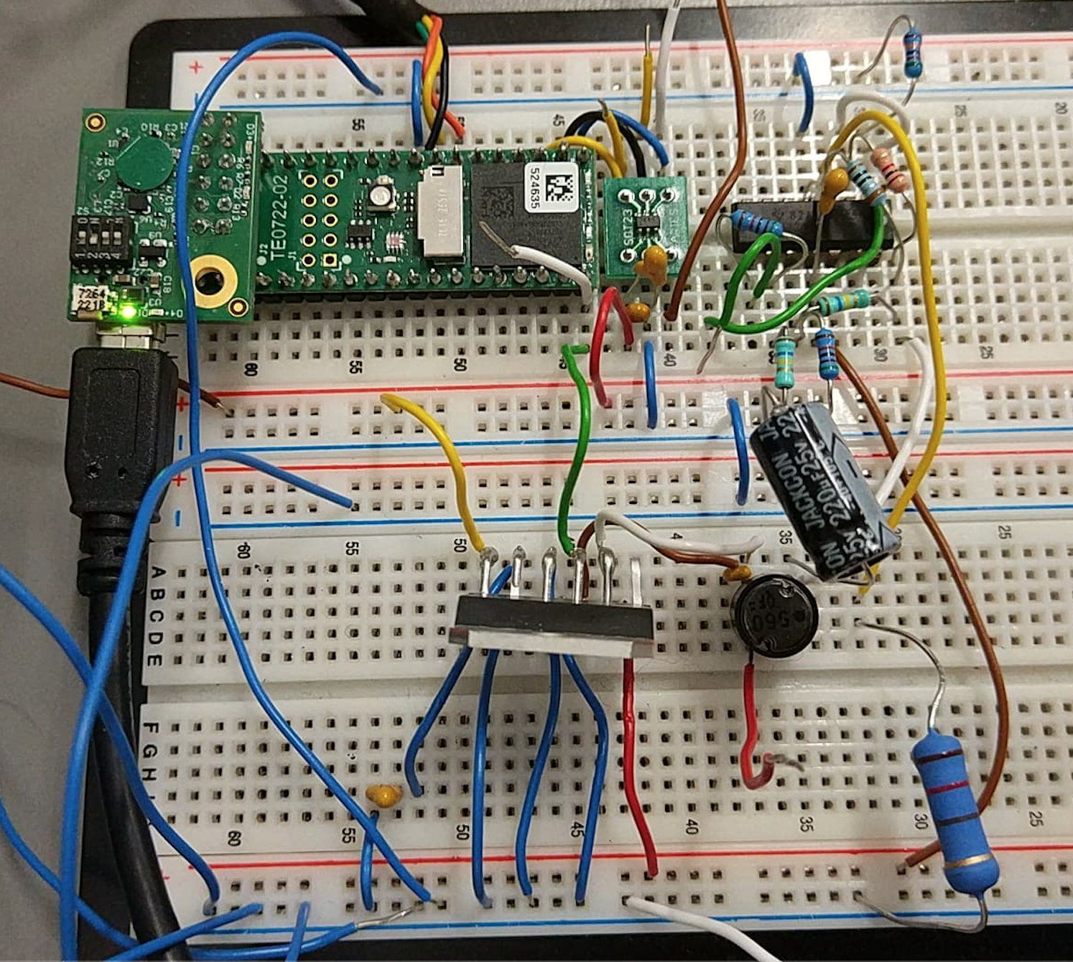
INTRODUCTION
Using a FPGA and some electronic components we want to perform a signal generator (voltage and current) for controlling a DC Motor.
In other words: we need a contant voltage modifiable according to a desired duty-cycle.
Notes:
THOR

Slide 3
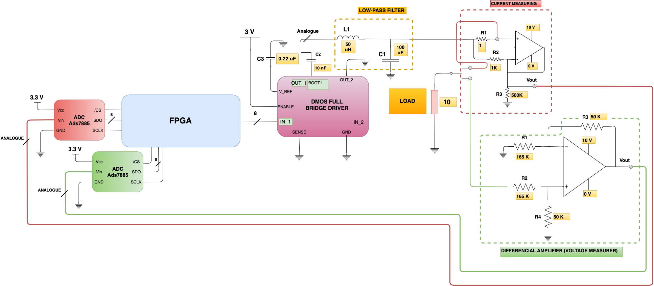
Notes:
THOR
- Connections
DMOS working as a switch
The filter working like a buck converter

Slide 4
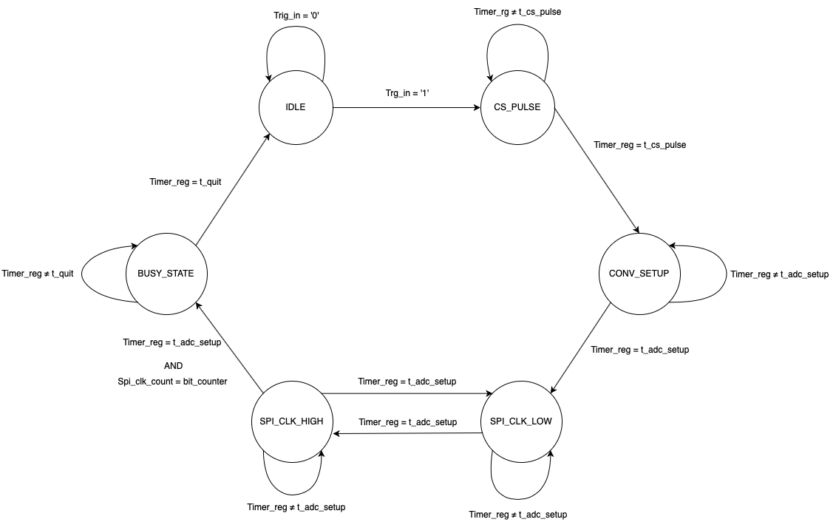
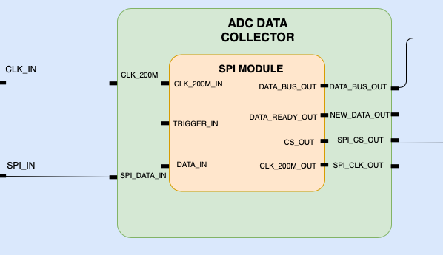
The SPI module is placed inside the ADC_Data_Collector and avoids the communication between it (slave) and the ADC (master)
SPI VHDL MODULE
Inside it a Finite States Machine, which state graph we can see in the figure, has been implemented
Notes:
PAULINE

Slide 5
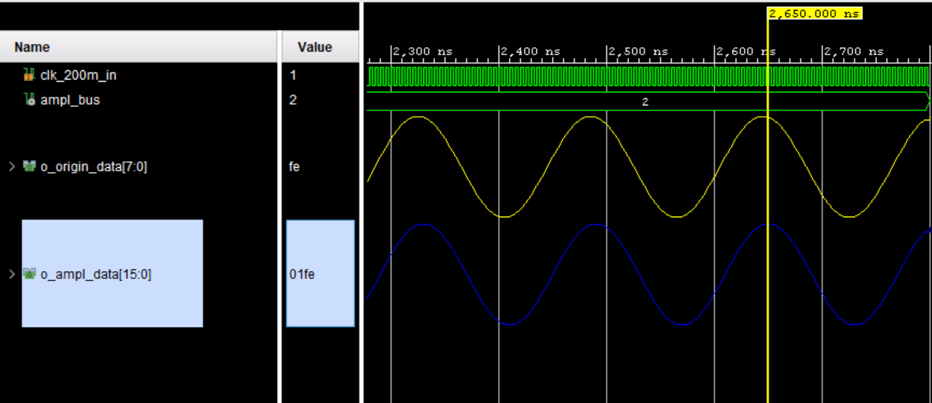
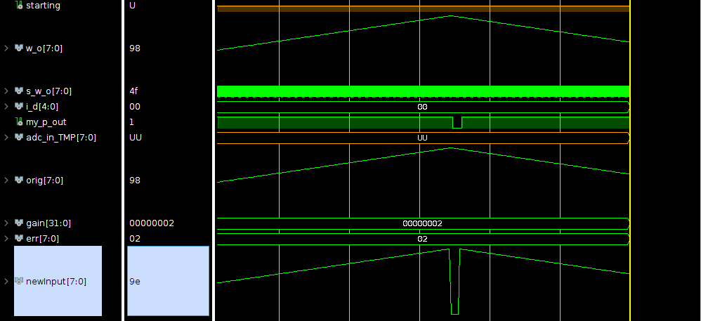
The Sin Wave Generator creates a “theoretical” sinusoidal wave.
SIN WAVE GENERATOR
VHDL MODULE
Sinusoidal wave
Triangular wave
Notes:
PAULINE

Slide 6
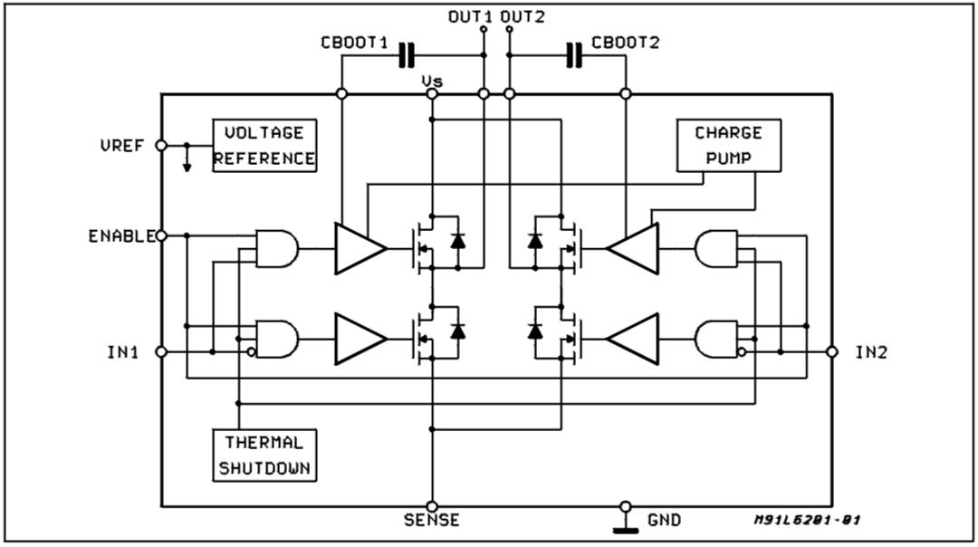
The PWM signal has 3 V, which is not enough for controlling the DC Motor. We need to increase it maintaining the frequency.
We only need one half-bridge because we work with an UNIPOLAR PWM.
When the PWM is HIGH, the top MOSFET is ON and we have 10 V in OUT1.
DMOS HALF-BRIDGE
When the PWM is LOW, the bottom MOSFET is ON and we have 0 V in OUT1.
With the half-bridge we are able to control an external voltage of 10 V with the PWM.
DMOS Half-Bridge Driver schematic
Notes:
JORGE

Slide 7
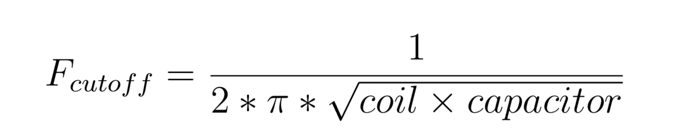
A DC Motor only can be controlled by a constant voltage (obviously).
DESIGN PROCESS
LOW-PASS FILTER
1. As a first aproximation we use a frequency of 2,4 kHz (10 times lower tan the PWM frequency):
Fcutoff = 2,4 kHz
Coil = 50 µH
Capacitor = 87 µF
That is the reason why a low-pass filter has been built before the motor (Power Resistance in our test set up)
2. However, that F_{cutoff} was not enough for getting a good constant wave:
Capacitor = 87 µF
Capacitor = 200 µF
3. With this value of capacitance we obtain a 1´6 kHz signal, which is more desirable.
Notes:
JORGE

Slide 8
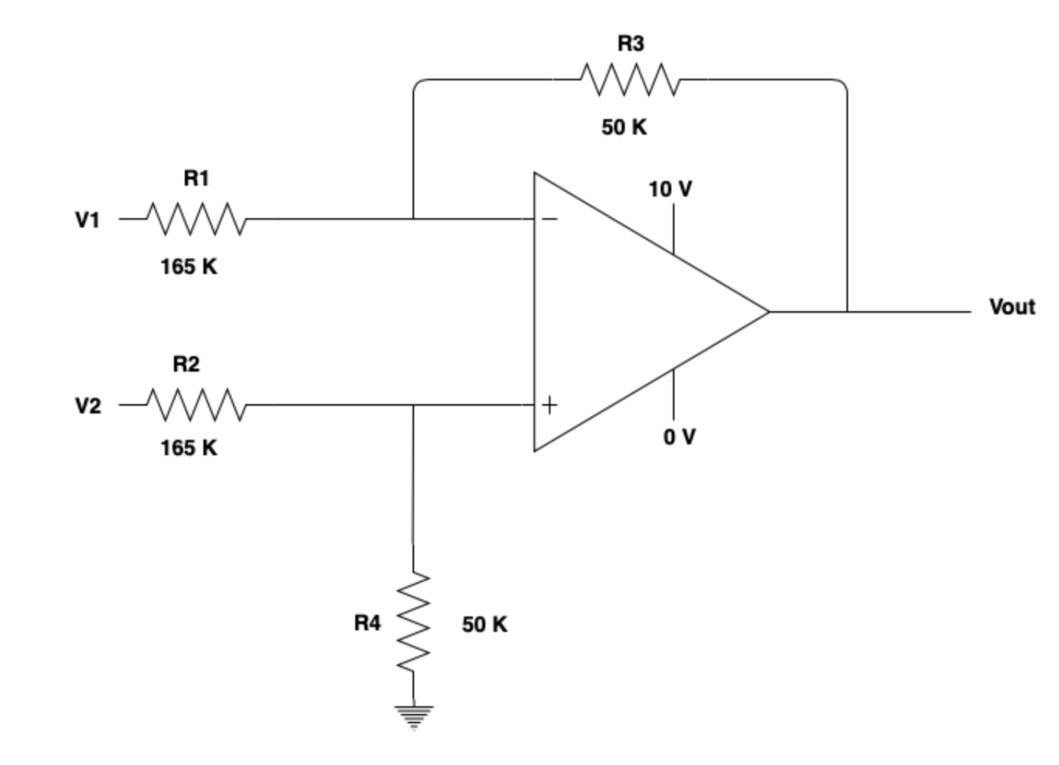
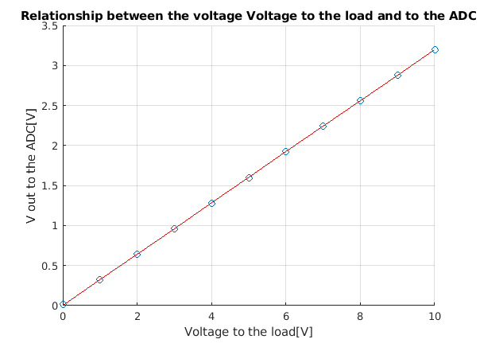
A differencial amplifier is needed for performing to actions:
Supposing 10 V (máximum) between V1 and V2 and 3 V in V_{out} :
R₁ = R₂ = 165 kΩ
R₃ = R₄ = 50 kΩ
DIFFERENCIAL AMPLIFIER
V_{out} = (R₃ /R₁)*(V₂-V₁)
Measure the voltage between the load terminals.
Scale down that voltage difference from 10V to 3V (maximum ADC input voltage)
Notes:
What is a differential amplifier?
- OP amps vs instrumentationel amps
How are we using it? – GND V1 and rescale from 10V to 3V. FInd resistor values

Slide 9
AS A BRIEF
CONCLUSION
AND
PHYSICAL DEMONSTRATION
Notes:
Buck converter taking an AC input and making it into a DC output from 0-supply.
Measure the voltage across the system
Did not measure the amps through the system.
– Could use an instrumental amp instead of op amp for current measurements.
Step 5 – combining tested modules and hardware.
Regulate voltage – Simulation and control it in real life.

